Slide 1




Cryptography 101
Sarang Parikh
Blockchain@NMIT, Intern Consensys
Notes:
http://www3.weforum.org/docs/WEF_The_future_of_financial_infrastructure.pdf

Slide 2
Cryptography 101
What’s Cryptography Anyway?
Cryptography involves creating written or generated codes that allow information to be kept secret.
Cryptography converts data into a format that is unreadable for an unauthorized user, allowing it to be transmitted without unauthorized entities decoding it back into a readable format, thus compromising the data.
In computer science, cryptography refers to secure information and communication techniques derived from mathematical concepts and a set of rule-based calculations called algorithms to transform messages in ways that are hard to decipher.

Slide 3
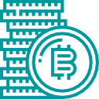



Blockchain Disruption 101
Evolution of blockchain protocols
From crypto-currencies to sophisticated business logics enabled by “smart contracts”
Bitcoin
Store and transact value (money)
Crypto-assets
Represent and transact other assets (physical or digital)
Smart contracts
Describe and execute complex business logics

Slide 4



Blockchain 101
What is a blockchain?
Originally conceived as the underlying protocol of Bitcoin, blockchain technology has since evolved to support a number of applications with the introduction of “smart contracts”
Immutable ledger
Blockchain is a write-once distributed database so it registers an immutable record of every transaction that occurs.
Cryptographically secure
Uses tried and true public/private signature technology. Blockchain applies this technology to create transactions that are impervious to fraud and establishes a shared truth.
Decentralized consensus
There are many replicas of the blockchain database and no one participant can tamper it. Consensus among the majority of participants is needed to update the database.
Smart contracts
The Ethereum blockchain can store and execute both data and Smart Contracts (“logic”) in the blockchain.

Slide 5





Blockchain 101
Immutability and security
Blockchain technology relies upon well established cryptography
Hashing functions
A one way transform of data into a unique, fixed length digest that cannot be reversed to produce inputs
HASHING
7b0f3bf1856ab4576595abc5f02c46cddcd259528191d9f6c78a89b0002816f2
Public-key cryptography
Enables encryption with a public key that can only be decrypted with a secret, private key and vice versa
ENCRYPT WITH PUBLIC KEY
DECRYPT WITH PRIVATE KEY
Digital signatures
A mathematical technique used to validate the authenticity, integrity and originator of a message
HASHING
7b0f3bf1856ab4576595abc5f02c46cddcd259528191d9f6c78a89b0002816f2
SIGNED WITH PRIVATE KEY

Slide 6

Blockchain 101
Decentralized consensus
Blockchain adds a way of achieving decentralized consensus to cryptographic security
“Proof of Work” consensus algorithm
In 2008 an individual or a group of individuals calling themselves Satoshi Nakamoto published the Bitcoin Whitepaper which described an innovative mechanism known as Proof of Work
Proof of Work is a computationally complex, energy and hardware intensive, puzzle with an easily verifiable proof used to verify transactions and determine an update to the distributed ledger
The first network participant (i.e. miner) to solve the puzzle receives a reward. Other network participants can easily verify the winner’s puzzle solution. If they agree, they then start solving the next puzzle which includes the next set of transactions.
Proof of Work enables consensus on the state of the network to be achieved without a central, controlling authority and without trust between the network participants
Notes:
Proof-of-Work (POW) is a guessing game with answers that are hard to discover but easy to verify
Every time somebody wins the guessing game, they get to suggest the next state of the system and create coins out of thin air and award them to themselves + transaction fees
The Bitcoin protocol determines a “difficulty” for the guessing game on the basis of how quickly people have been winning the guessing game on average over the previous 2016 rounds
Target 10 minutes per round on average

Slide 7
Blockchain 101
Smart contracts
Ethereum was the previous blockchain to introduce the notion of self-executing smart contracts
Smart contracts, Dapps and DAOs
Smart contracts are code that is stored on the blockchain and self-executes using the trust and security of the blockchain network.
They provide an application logic that runs in a distributed fashion on the Ethereum blockchain and operates using the power of the Turing-complete Ethereum Virtual Machine (EVM), allowing for enhanced or completely redesign business processes and services.
Collections of integrated smart contracts and traditional web technologies realize a new breed of decentralized applications (dapps) and a create a vision for decentralized autonomous organizations (DAOs)
Contract
<smart contract>
Offer
contract OfferContract {
uint public acceptance_rate = 50;
mapping (address => uint) tradeAccount;
mapping (address => uint) coinAccount;
address public owner;
function Consideration() {
owner = msg.sender;
}
modifier onlyOwner {
if (msg.sender != owner) sign;
}
function setAccept(uint rate) onlyOwner {
acceptance_rate = rate;
}
Consideration
Acceptance
</smart contract>
Notes:
One the computers in this network of distributed ledgers receive the code, they each come to an individual agreement on the results of the code execution (. The network would then update the distributed ledgers to record the execution of the contract, and then monitor for compliance with the terms of the smart contract. In this type of system, single party manipulation is overted because control over the execution of the smart contract is no longer possible because execution is no longer in the hands of a single party.

Slide 8
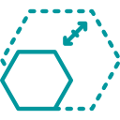





Blockchain 101
Technical and operational challenges
As with any emerging technology, limitations to the adoption of blockchain still exist but a talented and enthusiastic community is actively working to overcome such obstacles
Scalability
Proof of Work is not sustainable for higher volume of transactions
Latency
Current transaction speed and latency represent a limit to adoption for some use cases
Privacy
Pseudonymity doesn’t satisfy the privacy requirements for many use cases
Integration
Limited interoperability and integration between different protocols and legacy systems
Operating Model
Operation of new blockchain utilities and consortia requires new governance models
Regulations
The regulatory framework is still totally uncertain, limiting institutional adoption

Slide 9

Blockchain 101
Distributed business and operating models
Blockchain capabilities enable the transition to innovative and more efficient business and operating models that support the creation of green-field products and services
Distributed Business & Operating Models
Full provenance and transparency
Disintermediation and true P2P
Real-time transactions
Inclusion and participation
Green-field products and services
Tokens &
Smart Contracts
Registered on the distributed ledger
Programmable business logic
Deterministic and self-executing
Validated and executed through consensus
Automatically update the ledger
Blockchain
Consensus & DLT
Immutable, tamper-resistant and transparent
Decentralized, distributed and replicated
Consensus mechanism
Transaction validation and execution
P2P networking and messaging

Slide 10


Blockchain 101
Distributed and disintermediated models
A move toward distribution and disintermediation is a move toward scalability, resilience, efficiency, cost reduction, stability and reliability
Centralized Systems
Distributed Ledger
Slow, dependant, siloed system
Secure
shared source
of truth
Expensive
and
bloated
Need for a central authority
No need for central authority
Real-time data sharing
Corruptible, censorable, deletable
Immutable, uncensorable

Slide 11




Blockchain 101
Why blockchain?
Blockchain offers a number of benefits over traditional and legacy systems
Reduce costs
Removes cost of intermediaries and smart contract automation reduces manual processing, re-work, and processing errors
Reduce risk
No single point of failure or attack and non-repudiability reduces risk of fraud thanks to immutable audit trail and provenance
Increase revenues
Creation of new products and services and value capture from demonstrating provable provenance of commodity products
Improve speed and experience
Simplifies value chain by removing intermediaries and allows T+0 settlement

Slide 12




Blockchain 101
Social and political implications
Blockchain developments in the private and public sector have far reaching implications on society
Stronger cooperative economy
Disintermediate non value added activities to strengthen the participant's participation in the economy and their ability to capture value.
Social enterprise
The ability to trace transactions and set up organizations and voting mechanisms linked to reputation and identity will provide for the ability to recognize and report corruption. Immutable reputation will also incentivize best behavior.
New governance models
Ability for blockchain to organize and help in the delivery of projects through real time voting, which will have greater consequences when applied to liquid democracies, and prediction markets.
Self-sovereign identity
Individuals will control their identity which will greatly impact ability to gain access to credit, potential fluidity between geographies, and trade.
Accessible financial services
Bringing financial services to the billions of unbanked through near zero transaction fees and east of micropayments.

Slide 13
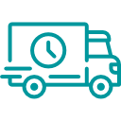






Art of The Possible
High potential use cases
Blockchain applications are emerging across many industries
Supply Chain
Provenance of assets become verifiable and traceable leading to the revolution of supply chains.
Governance
DAOs built on blockchains to maintain transparency and governance.
Self-sovereign identity
People and business own their own identity, with no central control, and build universal reputation.
Medical records
Personal ownership of medical records that can be used universally.
Decentralized storage
Does not require additional backups and disaster recovery. No central point of failure and control.
Creative work
Art ownership and distribution, where creators receive direct compensation for their work.
Fundraising
Initial Coin Offerings (ICOs) emerging as an alternative to venture capital.
IoT
Blockchain used as a means to connect and audit IoT, M2M value transfer.
Commodities trading
Tokenization, tracking and p2p trading of commodities, such as energy.

Slide 14




Art of the Possible
Blockchain enablers (1/2)
Key patterns enabling blockchain-based disruption
 | Description | Area of application | Example
Asset tokenization | Tokenization of physical and digital assets for trading and settlement with multiple parties on the blockchain | Real-world assets that are bound by the rules of traditional trust and distribution mechanisms | Loyalty programs: Unlocks the power of loyalty points by providing secondary markets & instant reconciliation
Custody & escrow | Trustless transaction capability with assets in escrow managed by a smart contract | Transactions involving intermediary agents who provides trust as a service between two or more trading parties | Betting/Gambling: Funds used to stake a bet are held in escrow on the smart contract until winner is decided
Provenance & tracking | Single source of truth that conveys information about the asset across its journey from one custodian to the next | Traditional supply chains that use conventional methods to track the custody of an asset | Supply chain: Asset tracking processes reimagined on blockchain for tracking of tokenized physical assets
Accounting & reconciliations | New accounting paradigm where every debit and credit is recorded with an immutable entry on the blockchain | Traditional double-entry bookkeeping systems with disparate sources and uses of data in need of reconciliation | Trading books: Automated reconciliation of trading positions among financial institutions

Slide 15

Art of the Possible
Blockchain enablers (2/2)
Key patterns enabling blockchain-based disruption
 | Description | Area of application | Example
Digital identity | Consolidation and management of individual / entity ID with attributes stored and verified on a blockchain | Multiple sources of identification with disparate data points and potential risk of duplication | Medical records: Holistic records management enables patient profiling and effective treatment
Real-time transactions | Atomic transactions ensure that ‘the trade is the settlement’ thus bringing the lag time to negligible minimum | Conventional systems where there is significant intermediation and time lag before final settlement | Capital markets: Instant settlement of trades removes reconciliations and improved capital efficiency
Micro payments & funding | Transactions of minimum value that enable P2P payments, M2M payments and capital raising | Traditional commercial transactions where small sale amount are made anti-economical by payment fees | Publishing: Distribution of single pieces of content charging a micro fee rather than subscription
Automated execution | Full automation of contract lifecycle form issuance, transfers, revisions and up to final execution | Conventional contract and security issuance process that depends on multiple intermediaries | Property sale: Title update and execution through property development and sales process

Slide 16
Art of the Possible
Blockchain impact on Accounting
Shared Infrastructure
Value is the Record
Digitized
Value
Capital Structuring

Slide 17
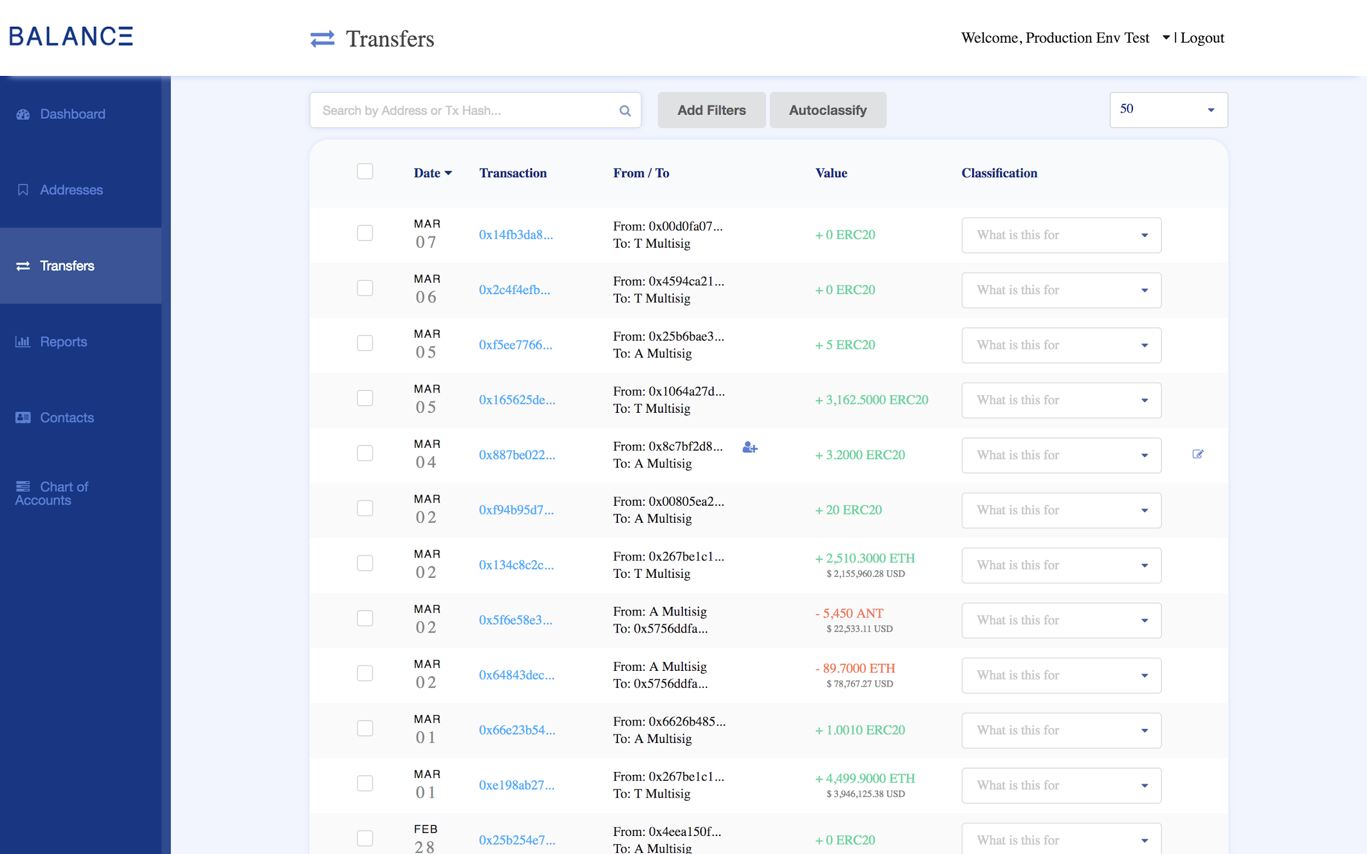
Art of the Possible
Balanc3 Software

Slide 18

Art of the Possible
Accounting Blockchain Coalition
Largest group of Accounting Firms, Law Firms, Universities, Technology Companies, and Crypto Startups addressing industry wide accounting issues

Slide 19


A Formation
Griffin Anderson
griffin.anderson@consensys.net
© 2017 BALANC3

